Slide 1
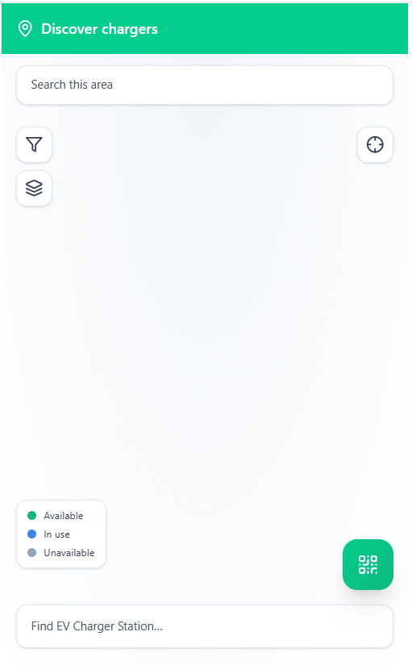
BATCH_02_MAP_STATIONS_MOBILE_REACT_TAILWIND_JS
This is the Landing Screen for Public Charging

Slide 2
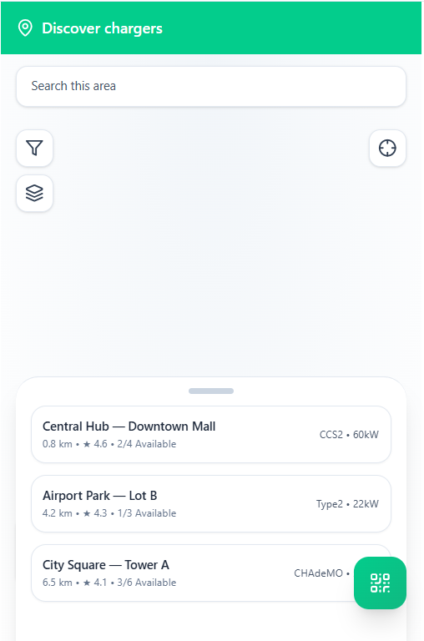
BATCH_01_DISCOVER_MAP_LIST_LEGEND_MOBILE_REACT_TAILWIND_JS
This appears after a user taps the search area
Re align the “Scan QR code” button not to overlap the suggested stations

Slide 3
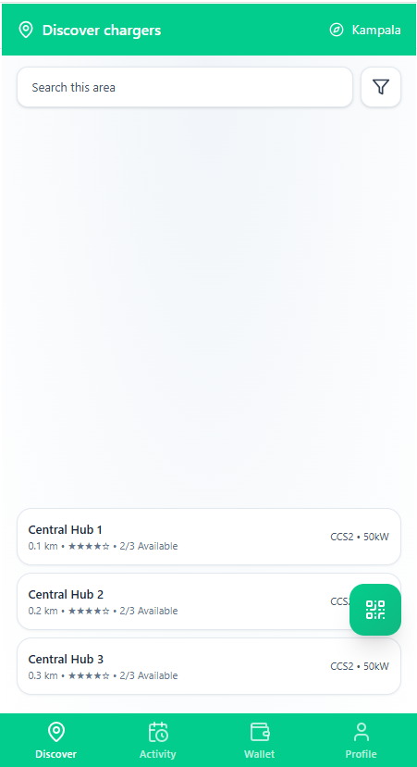
APP_SHELL_EVZ_MOBILE_CORE_REACT_TAILWIND_JS
This appears after a user taps the search area

Slide 4
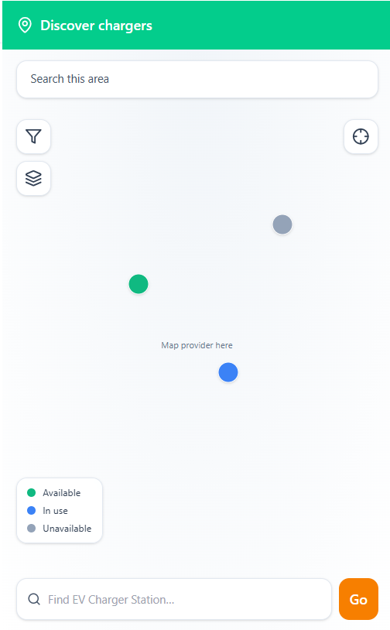
P_0_01_CORE_MAP_WRAPPER_SEARCH_MOBILE_REACT_TAILWIND_JS

Slide 5
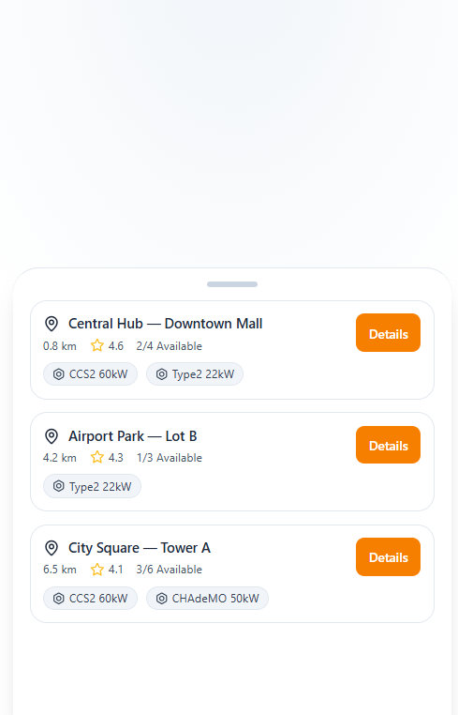
BATCH_02_STATION_LIST_SHEET_MOBILE_REACT_TAILWIND_JS

Slide 6
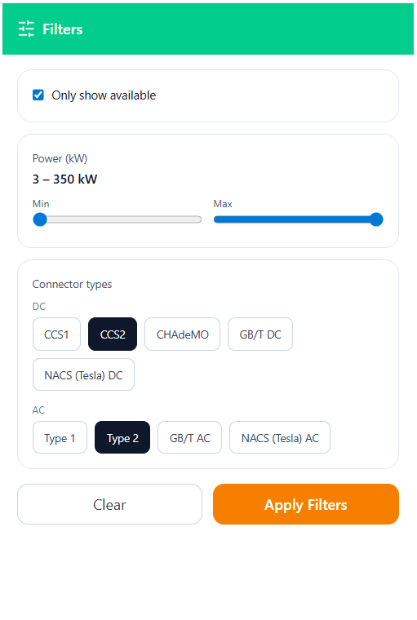
BATCH_01_FILTER_HUB_POWER_CONNECTOR_AVAILABILITY_MOBILE_REACT_TAILWIND_JS

Slide 7
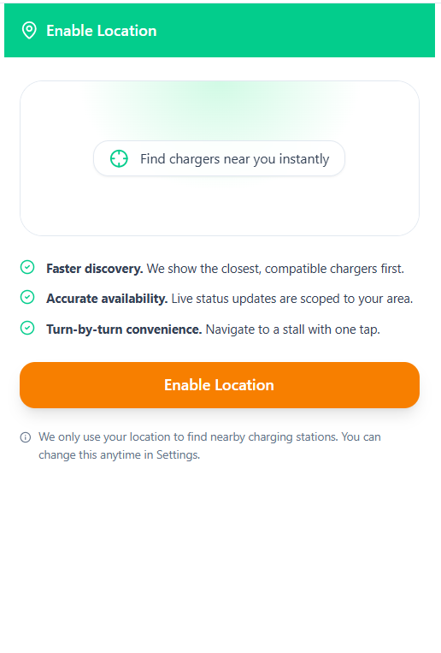
BATCH_01_LOCATION_PERMISSION_MOBILE_REACT_TAILWIND_JS

Slide 8
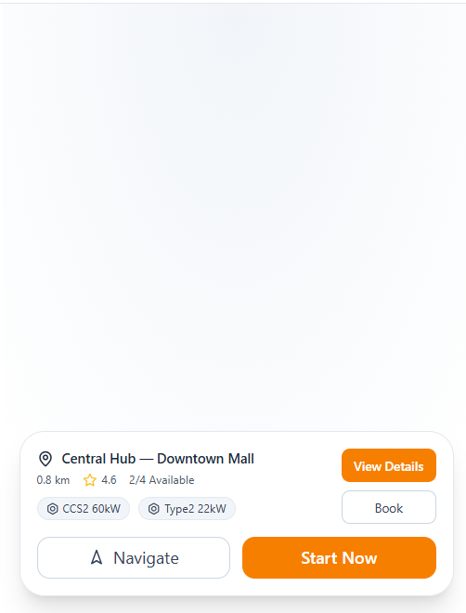
BATCH_02_STATION_CARD_PREVIEW_TAP_SHEET_MOBILE_REACT_TAILWIND_JS

Slide 9
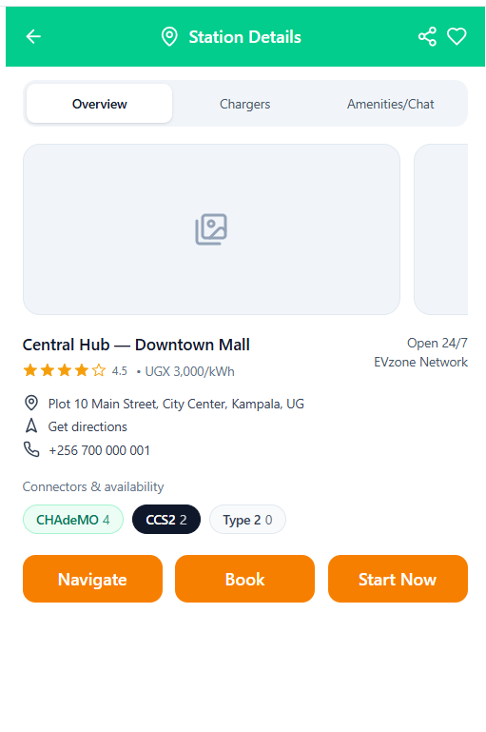
BATCH_02_STATION_DETAILS_OVERVIEW_UPDATED_MOBILE_REACT_TAILWIND_JS

Slide 10
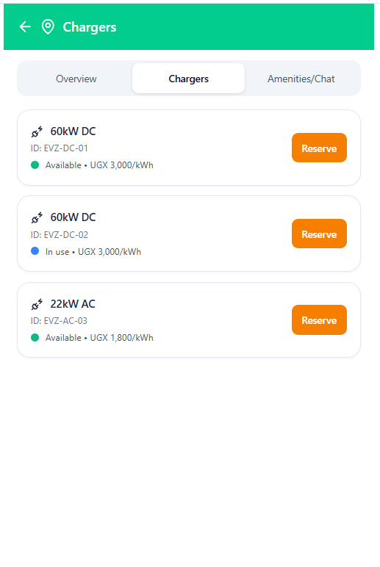

Slide 11
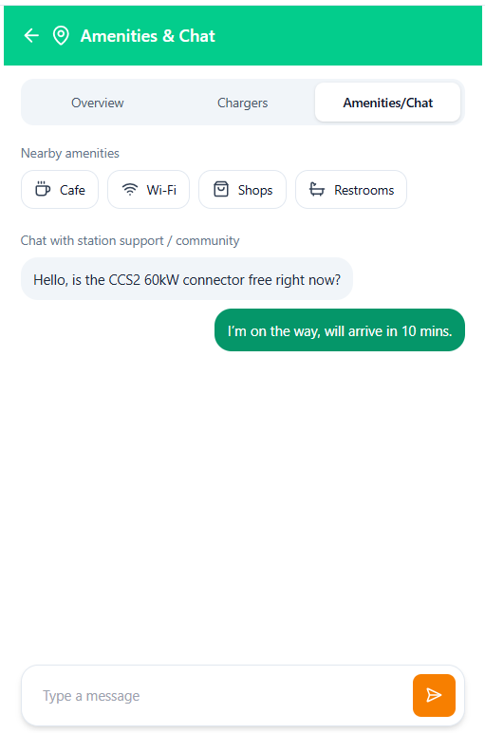
BATCH_02_STATION_DETAILS_AMENITIES_CHAT_MOBILE_REACT_TAILWIND_JS

Slide 12
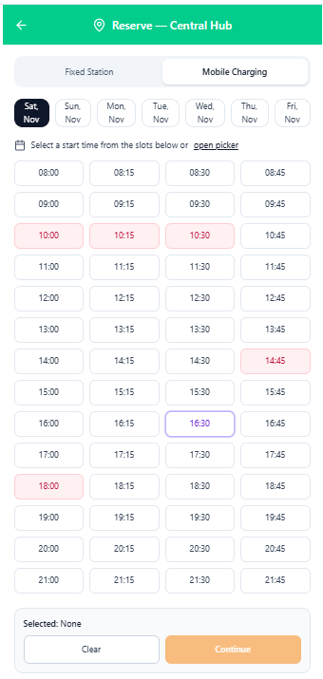
BATCH_03_BOOKING_FIXED_CHOOSE_TIME_MOBILE_REACT_TAILWIND_JS

Slide 13
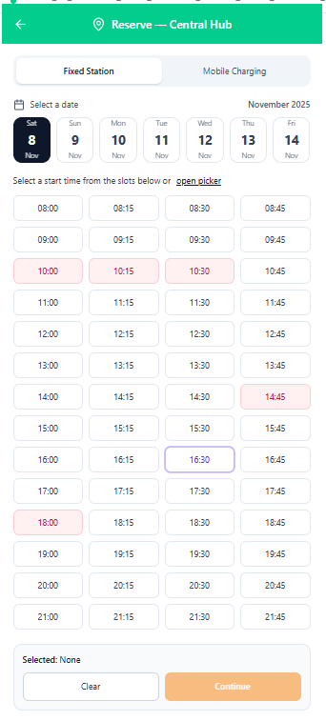
BATCH_03_BOOKING_FIXED_PAYMENT_MOBILE_REACT_TAILWIND_JS

Slide 14
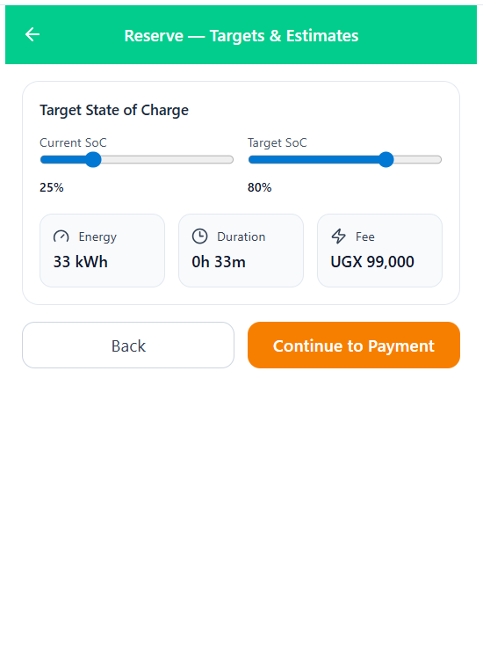
BATCH_03_BOOKING_FIXED_TARGETS_ESTIMATES_MOBILE_REACT_TAILWIND_JS

Slide 15
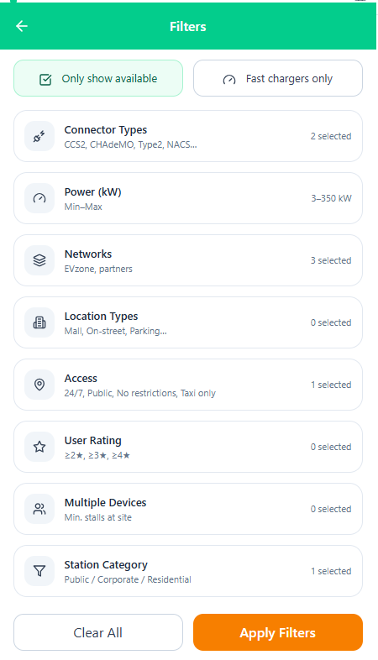
BATCH_03_FILTER_HUB_SHEET_MOBILE_REACT_TAILWIND_JS

Slide 16
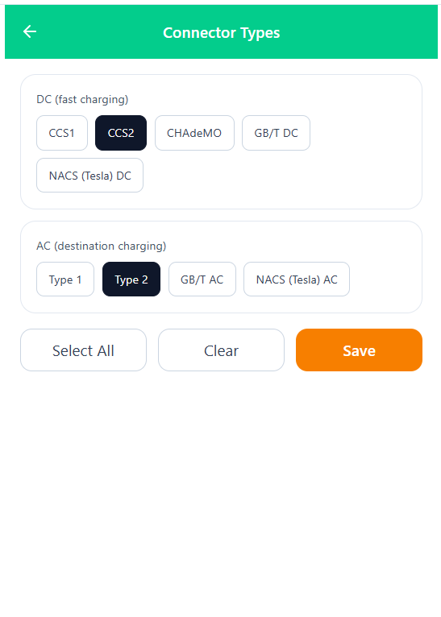
BATCH_03_FILTER_CONNECTOR_TYPES_MOBILE_REACT_TAILWIND_JS

Slide 17
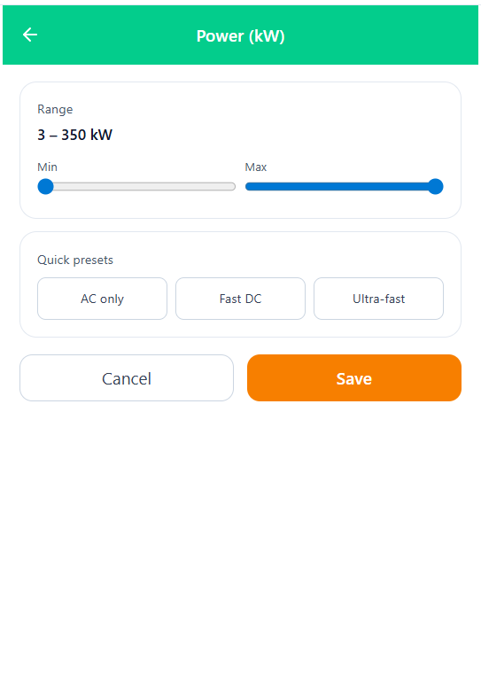
BATCH_03_FILTER_POWER_K_W_MOBILE_REACT_TAILWIND_JS

Slide 18
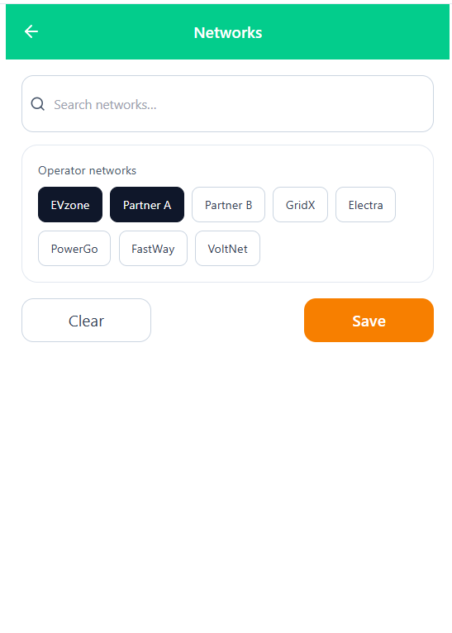
BATCH_04_FILTER_NETWORKS_MOBILE_REACT_TAILWIND_JS

Slide 19
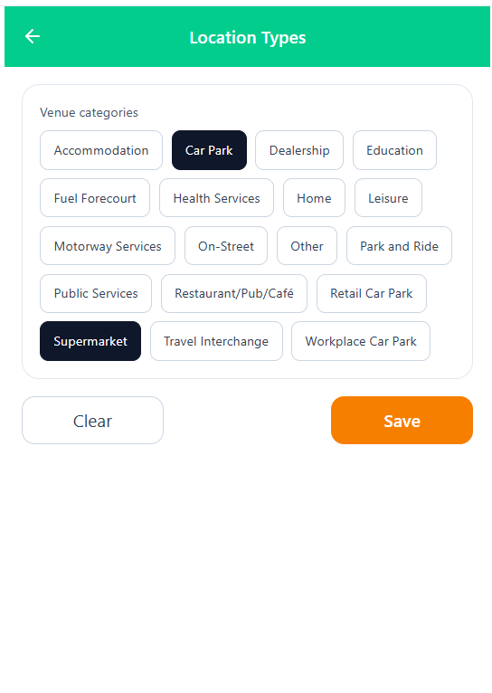
BATCH_04_FILTER_LOCATION_TYPES_MOBILE_REACT_TAILWIND_JS

Slide 20
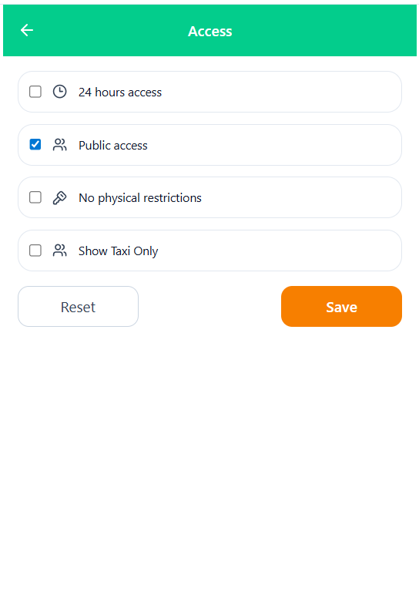
BATCH_04_FILTER_ACCESS_MOBILE_REACT_TAILWIND_JS

Slide 21
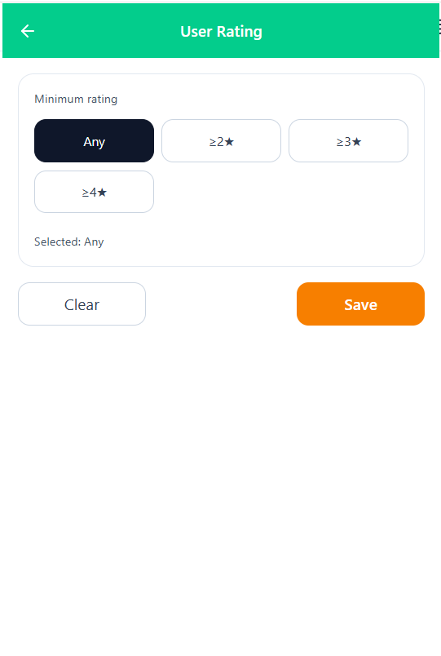

Slide 22
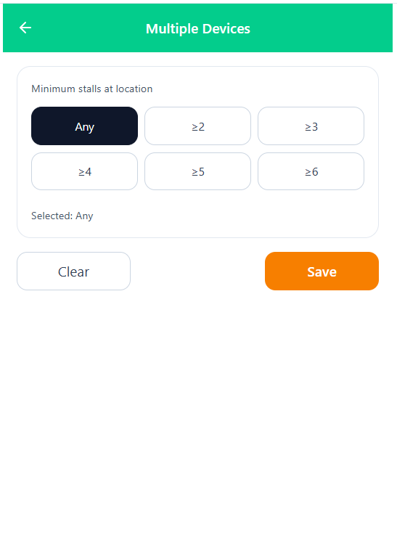
BATCH_05_FILTER_MULTIPLE_DEVICES_MOBILE_REACT_TAILWIND_JS

Slide 23
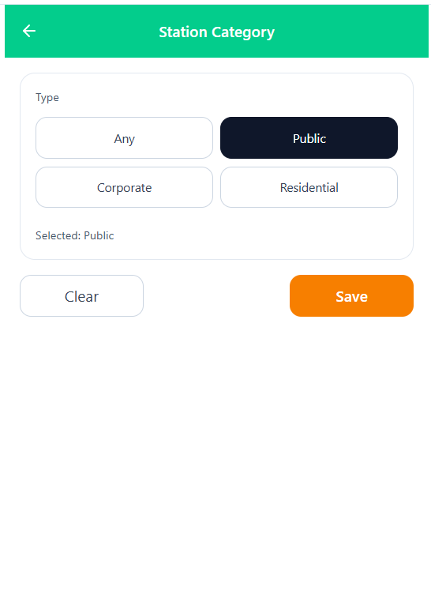
BATCH_05_FILTER_STATION_CATEGORY_MOBILE_REACT_TAILWIND_JS

Slide 24
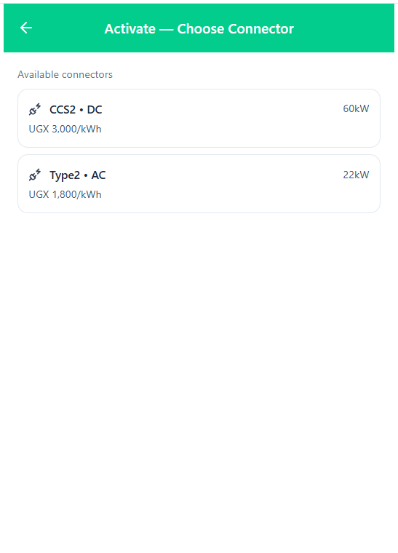
BATCH_04_ACTIVATION_CHOOSE_CONNECTOR_PREPAID_ORDER_MOBILE_REACT_TAILWIND_JS

Slide 25
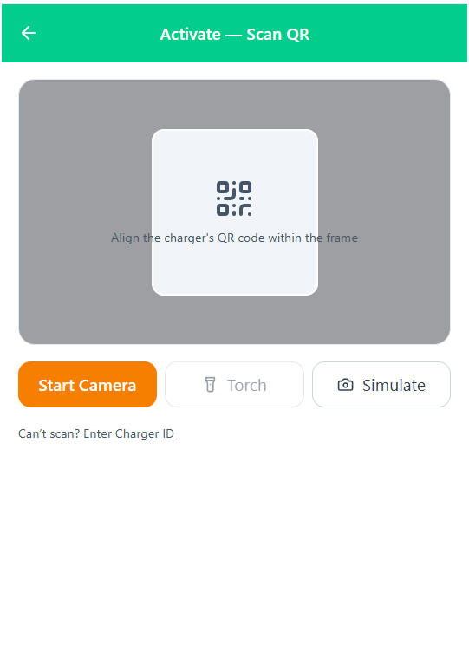
BATCH_04_ACTIVATION_SCAN_QR_MOBILE_REACT_TAILWIND_JS

Slide 26
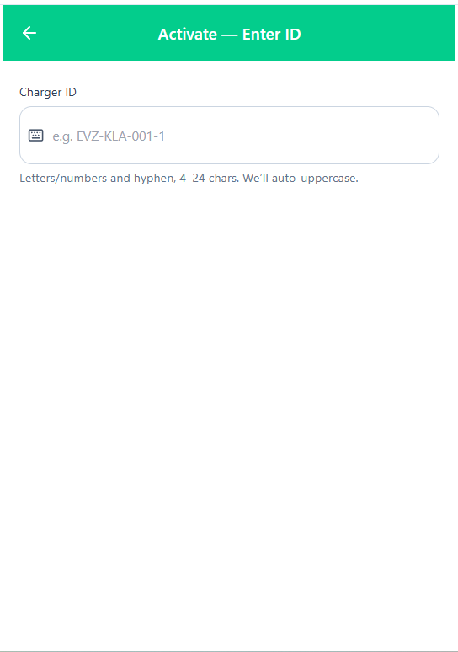
BATCH_04_ACTIVATION_ENTER_CHARGER_ID_MOBILE_REACT_TAILWIND_JS

Slide 27
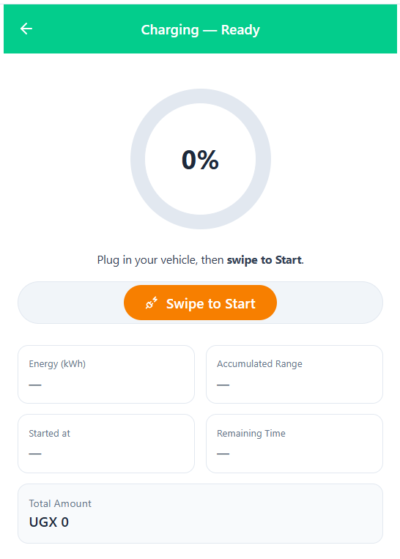
BATCH_05_CHARGING_READY_MOBILE_REACT_TAILWIND_JS

Slide 28
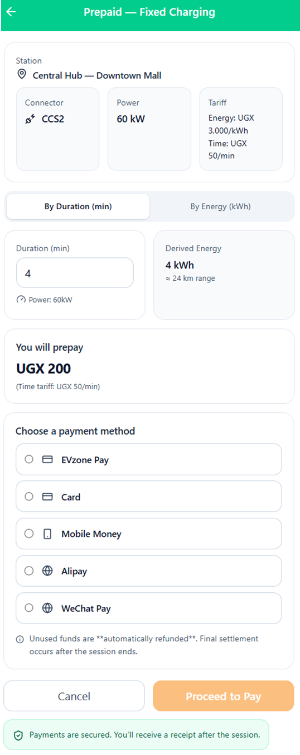
PREPAID_FIXED_CHARGING_MOBILE_REACT_TAILWIND_JS

Slide 29
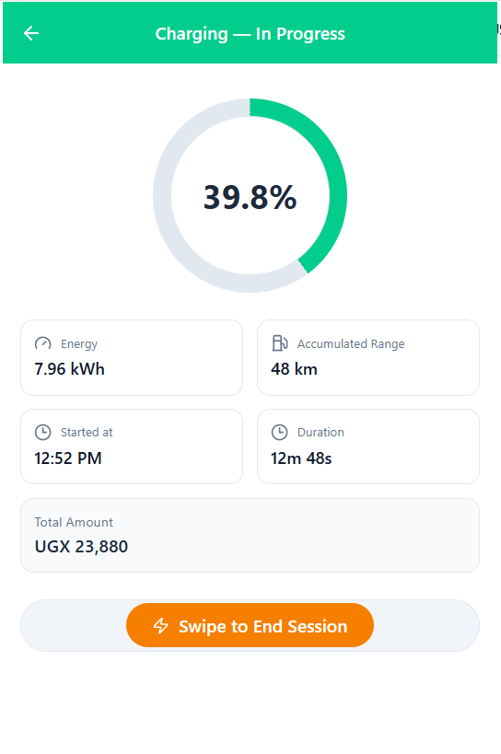
BATCH_05_CHARGING_IN_PROGRESS_MOBILE_REACT_TAILWIND_JS

Slide 30

BATCH_05_CHARGING_STOP_CONFIRMATION_MOBILE_REACT_TAILWIND_JS

Slide 31
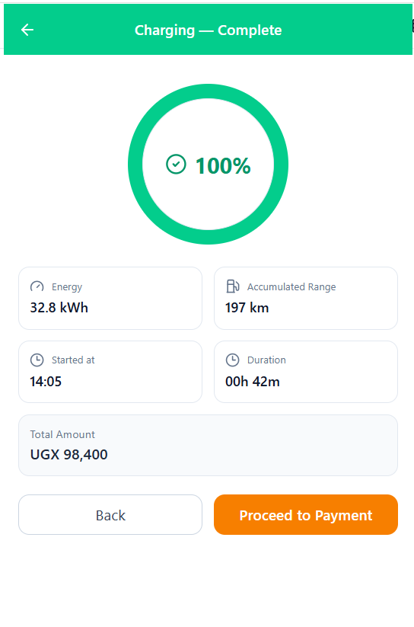
BATCH_06_CHARGING_COMPLETE_MOBILE_REACT_TAILWIND_JS

Slide 32
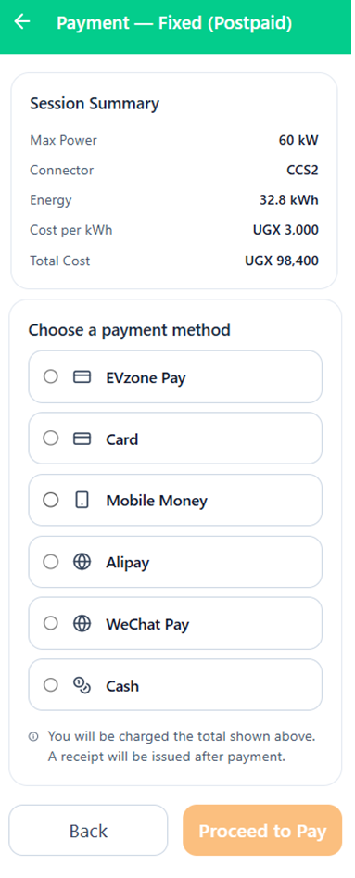
PAYMENT_FIXED_CHARGING_POSTPAID_CASH_ENABLED_MOBILE_REACT_TAILWIND_JS

Slide 33
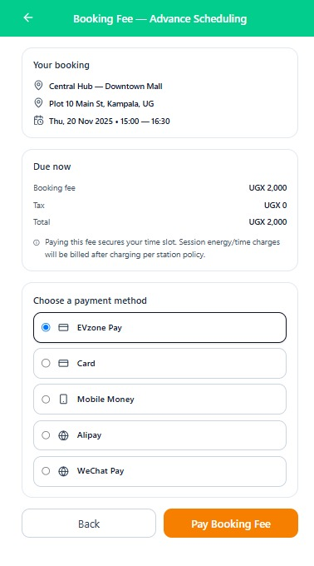
BOOKING_FEE_ADVANCE_SCHEDULING_PREVIEW_MOBILE_REACT_TAILWIND_JS

Slide 34
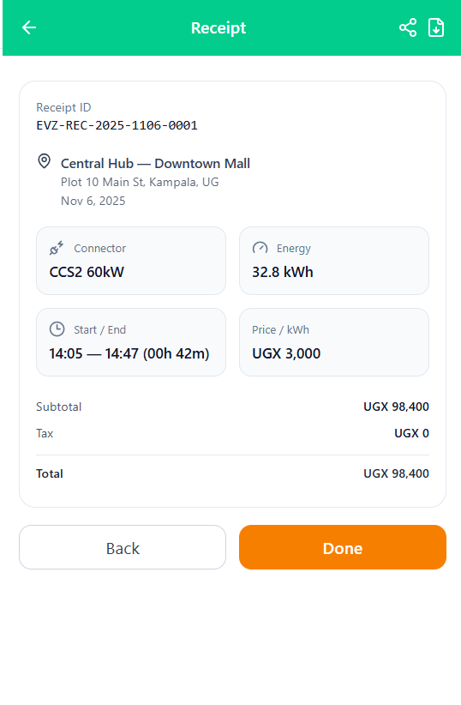

Slide 35
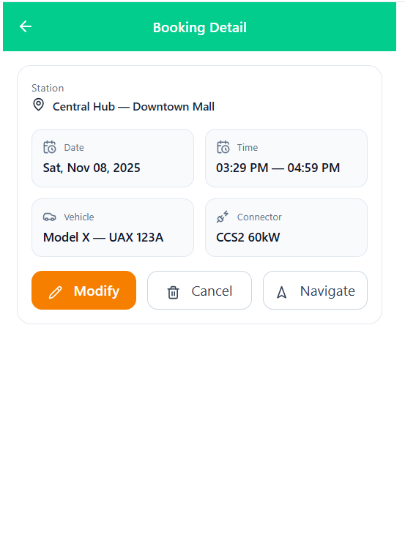
BATCH_07_BOOKING_DETAIL_MOBILE_REACT_TAILWIND_JS

Slide 36
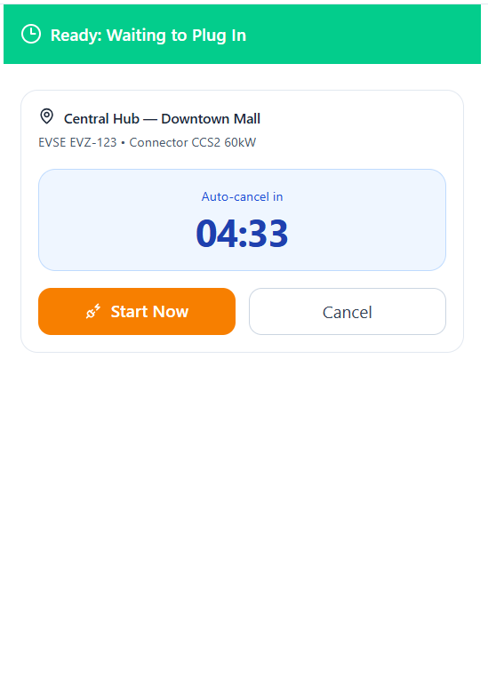
BATCH_07_READY_WAITING_TO_PLUG_IN_MOBILE_REACT_TAILWIND_JS

Slide 37
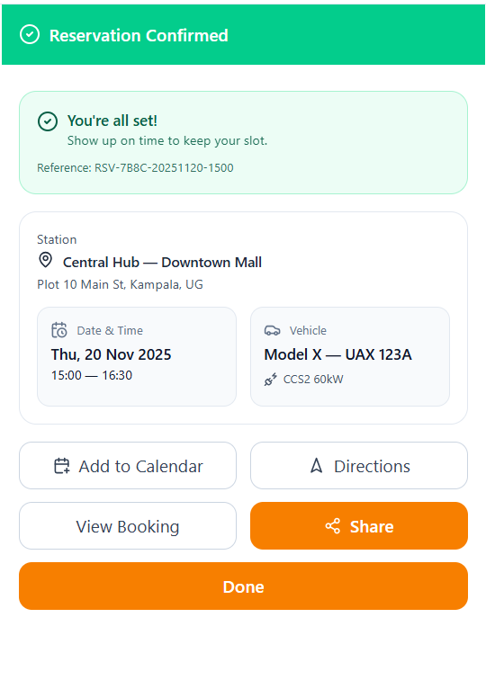

Slide 38
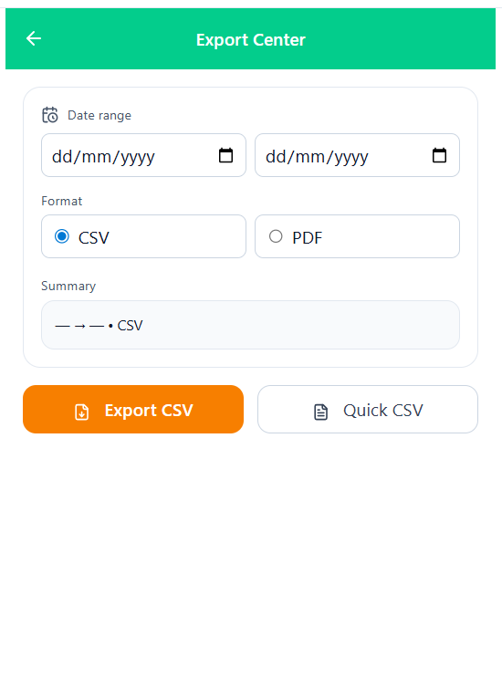
BATCH_08_EXPORT_CENTER_MOBILE_REACT_TAILWIND_JS

Slide 39
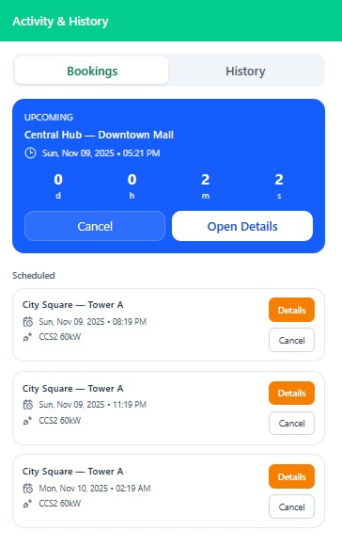
ACTIVITY_HISTORY_UNIFIED_TOGGLE_MOBILE_REACT_TAILWIND_JS

Slide 40
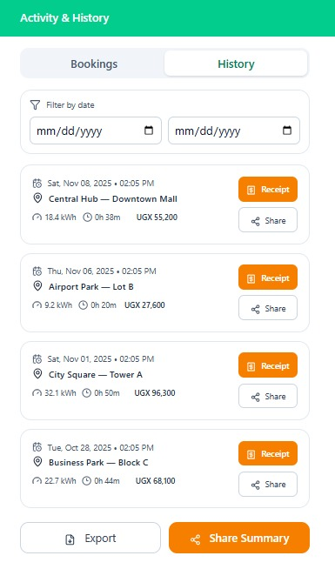
ACTIVITY_HISTORY_UNIFIED_TOGGLE_MOBILE_REACT_TAILWIND_JS

Slide 41
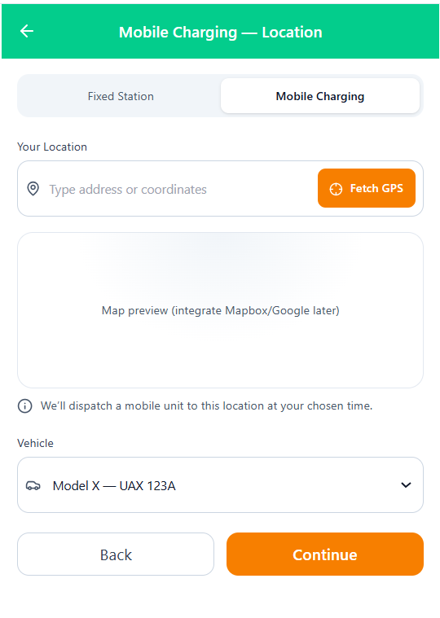
BATCH_09_BOOKING_MOBILE_LOCATION_MOBILE_REACT_TAILWIND_JS

Slide 42
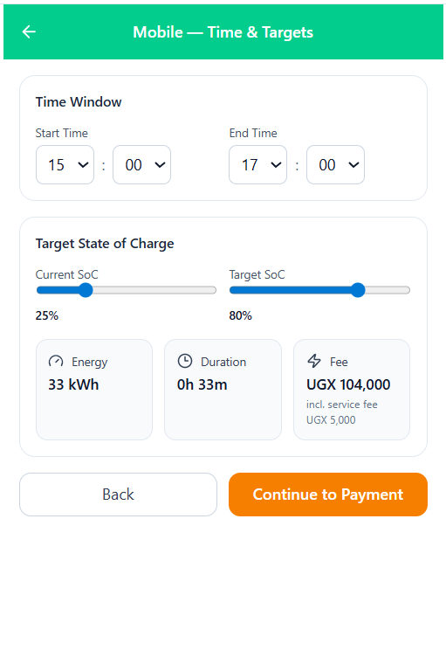
BATCH_09_BOOKING_MOBILE_TIME_TARGETS_MOBILE_REACT_TAILWIND_JS

Slide 43
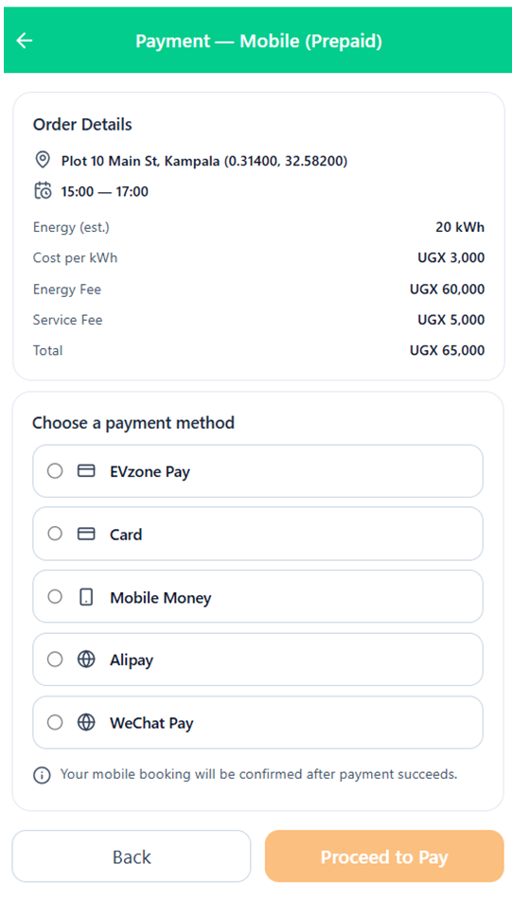
PAYMENT_MOBILE_CHARGING_PREPAID_MOBILE_REACT_TAILWIND_JS

Slide 44
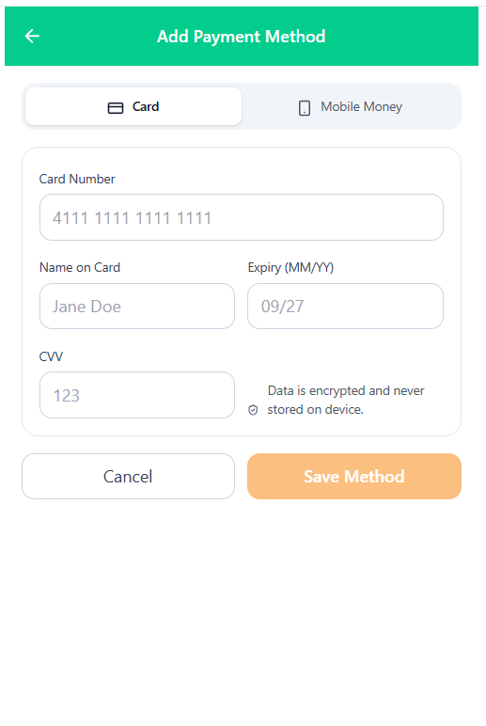
BATCH_10_ADD_PAYMENT_METHOD_MOBILE_REACT_TAILWIND_JS

Slide 45
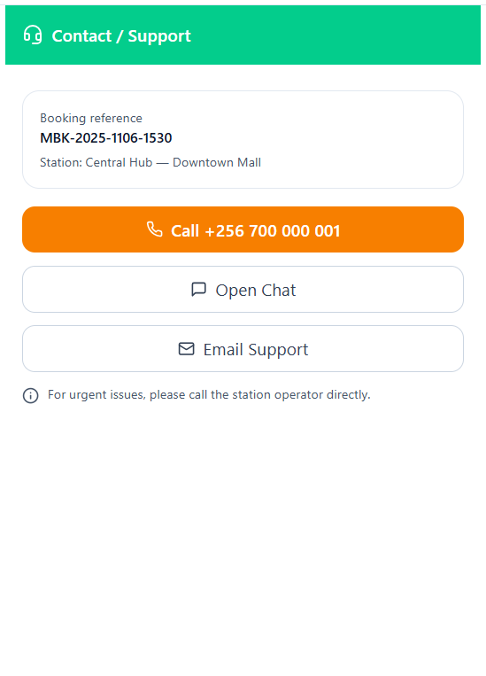
BATCH_10_CONTACT_SUPPORT_QUICK_ACTION_MOBILE_REACT_TAILWIND_JS

Slide 46
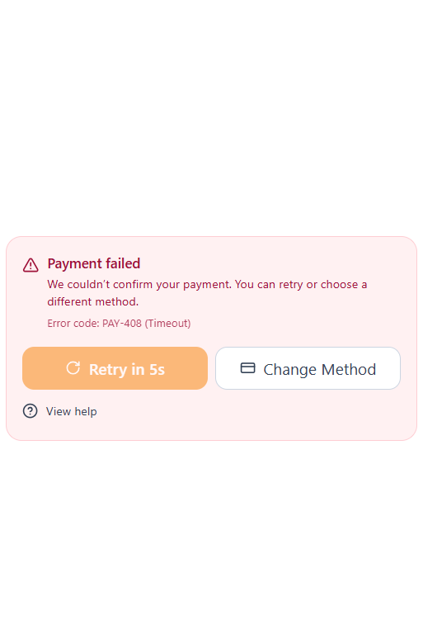
BATCH_10_PAYMENT_ERROR_TIMEOUT_MOBILE_REACT_TAILWIND_JS

Slide 47
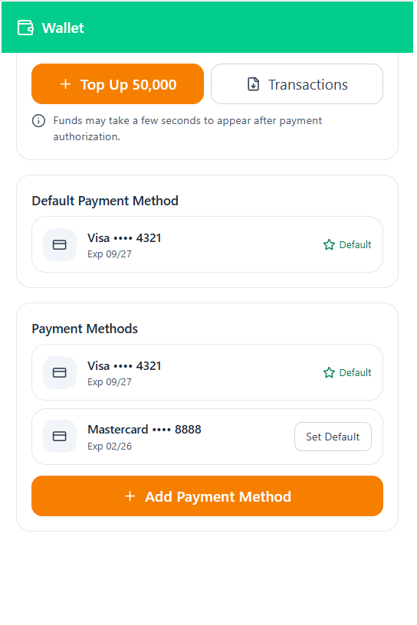
BATCH_10_WALLET_HOME_MOBILE_REACT_TAILWIND_JS

Slide 48
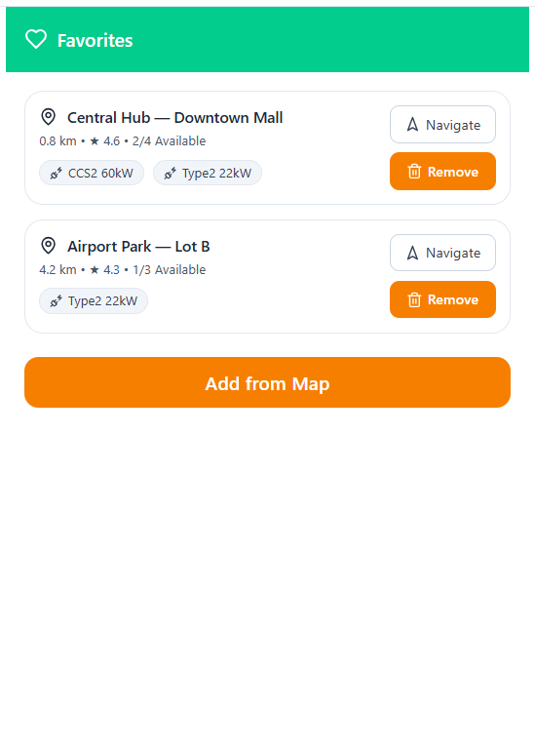
BATCH_12_FAVORITES_MOBILE_REACT_TAILWIND_JS

Slide 49
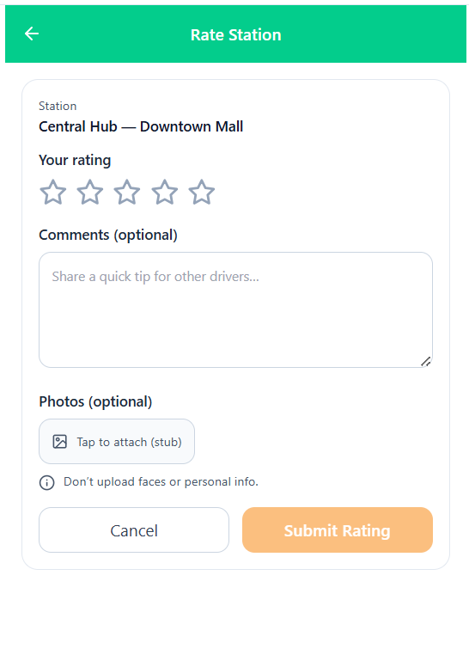
BATCH_12_RATE_STATION_MOBILE_REACT_TAILWIND_JS

Slide 50
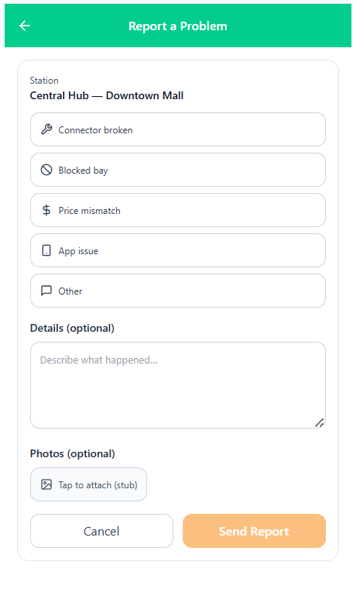
BATCH_12_REPORT_A_PROBLEM_MOBILE_REACT_TAILWIND_JS

Slide 51
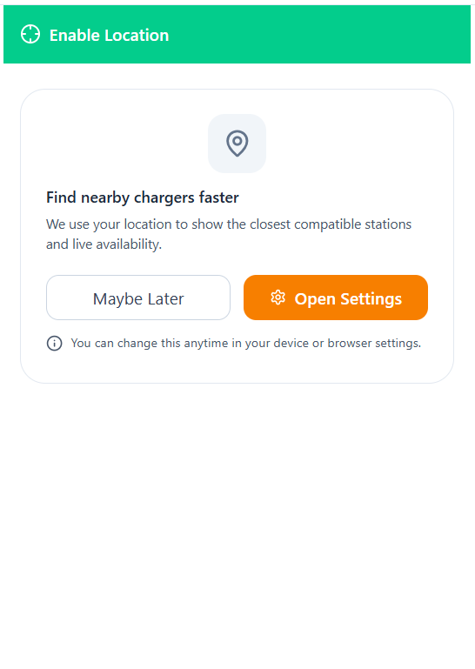
BATCH_13_SYSTEM_LOCATION_OFF_MOBILE_REACT_TAILWIND_JS

Slide 52

BATCH_13_SYSTEM_NO_STATIONS_FOUND_MOBILE_REACT_TAILWIND_JS

Slide 53


Slide 54

BATCH_14_DR_PEAK_EVENT_BANNER_MOBILE_REACT_TAILWIND_JS

Slide 55


Slide 56

BATCH_14_ROAMING_NETWORK_BADGES_MOBILE_REACT_TAILWIND_JS

Slide 57

BATCH_20_CHARGER_UNAVAILABLE_MOBILE_REACT_TAILWIND_JS

Slide 58

BATCH_20_CONNECTOR_MISMATCH_MOBILE_REACT_TAILWIND_JS

Slide 59

BATCH_11_COMPATIBILITY_HELPER_MOBILE_REACT_TAILWIND_JS

Slide 60

BATCH_20_RESERVATION_NOT_READY_MOBILE_REACT_TAILWIND_JS

Slide 61

BATCH_21_NOTIFICATION_SETTINGS_MOBILE_REACT_TAILWIND_JS

Slide 62


Slide 63

BATCH_21_TEST_NOTIFICATION_MOBILE_REACT_TAILWIND_JS

Slide 64

BATCH_22_LANGUAGE_UNITS_MOBILE_REACT_TAILWIND_JS

Slide 65

BATCH_22_PRIVACY_SUPPORT_MOBILE_REACT_TAILWIND_JS

Slide 66

BATCH_22_PROFILE_SETTINGS_MOBILE_REACT_TAILWIND_JS

Slide 67


Slide 68


Slide 69

P_0_02_BOOKING_MODIFY_RESCHEDULE_MOBILE_REACT_TAILWIND_JS

Slide 70

P_0_03_RESERVATION_EXPIRED_CANCELLED_MOBILE_REACT_TAILWIND_JS

Slide 71


Slide 72

P_0_06_PAYMENT_3_D_SECURE_OTP_HANDOFF_MOBILE_REACT_TAILWIND_JS

Slide 73


Slide 74

P_0_08_CAMERA_PERMISSION_EXPLAINER_MOBILE_REACT_TAILWIND_JS

Slide 75

P_0_09_SCAN_FAILED_RETRY_MOBILE_REACT_TAILWIND_JS

Slide 76

P_0_10_RESUME_ACTIVE_CHARGING_PROMPT_MOBILE_REACT_TAILWIND_JS

Slide 77


